Slide 1
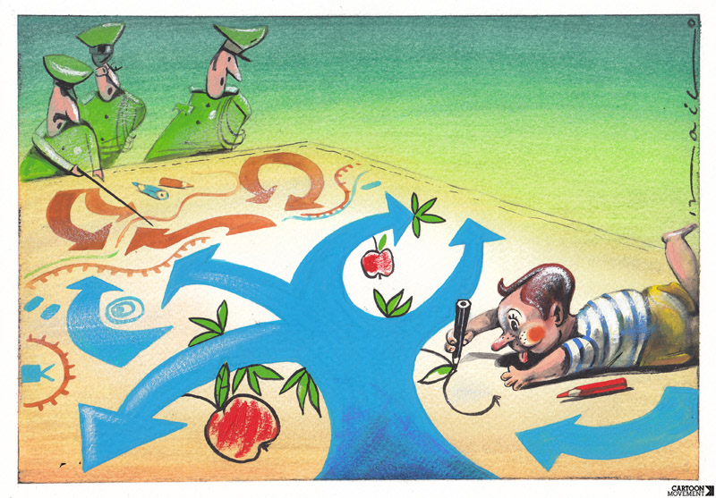
CHILDREN‘S RIGHTS
Charalampos Papaioannou

Slide 2
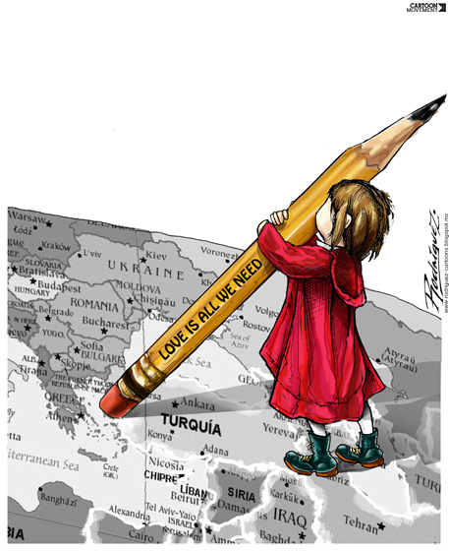
The Convention on the Rights of the Child
(commonly abbreviated as the CRC or UNCRC) was first signed on 20 November 1989 in New York, and came into force on 2 September 1990.
Today, 196 different countries are party to it. However,
Which are the Rights of the Child?
In this presentation, I’m going to showcase the most important of them , since they count up to 54 rights in total.

Slide 3
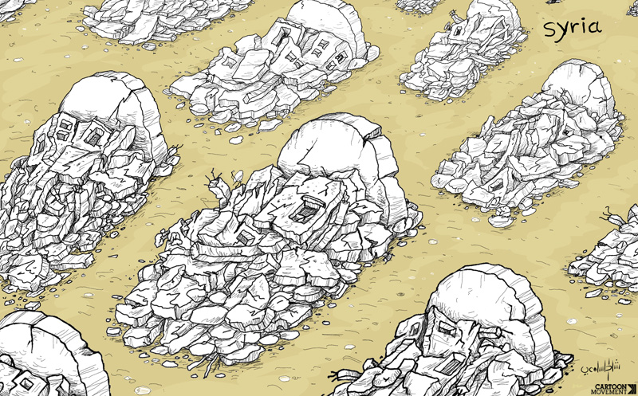
Article 6 1. States Parties recognize that every child has the inherent right to life.
2. States Parties shall ensure to the maximum extent possible the survival and development of the child.
In other words,
you have the right to live.

Slide 4
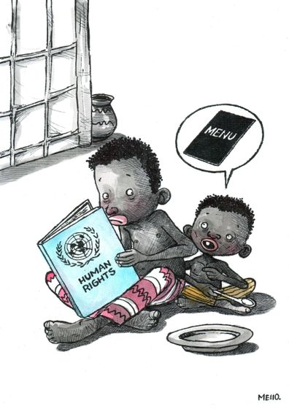
Article 12
1. States Parties shall assure to the child who is capable of forming his or her own views the right to express those views freely in all matters affecting the child, the views of the child being given due weight in accordance with the age and maturity of the child.
2. For this purpose, the child shall in particular be provided the opportunity to be heard in any judicial and administrative proceedings affecting the child, either directly, or through a representative or an appropriate body, in a manner consistent with the procedural rules of national law.
That means that you have the right to express your opinion, and for adults to listen and take it seriously.

Slide 5
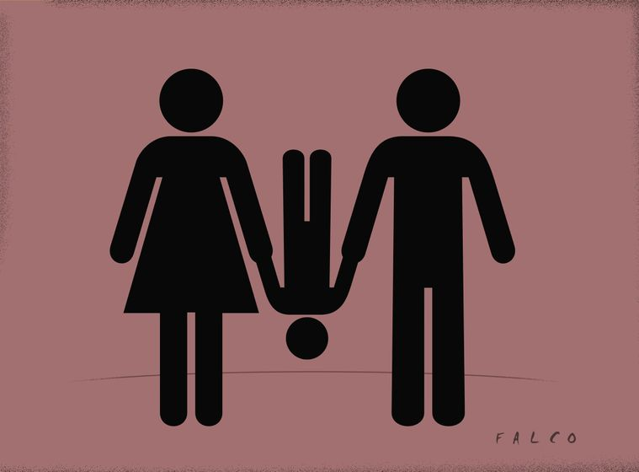
Article 16
1. No child shall be subjected to arbitrary or unlawful interference with his or her privacy, family, home or correspondence, nor to unlawful attacks on his or her honour and reputation.
2. The child has the right to the protection of the law against such interference or attacks.
You have the right to privacy

Slide 6
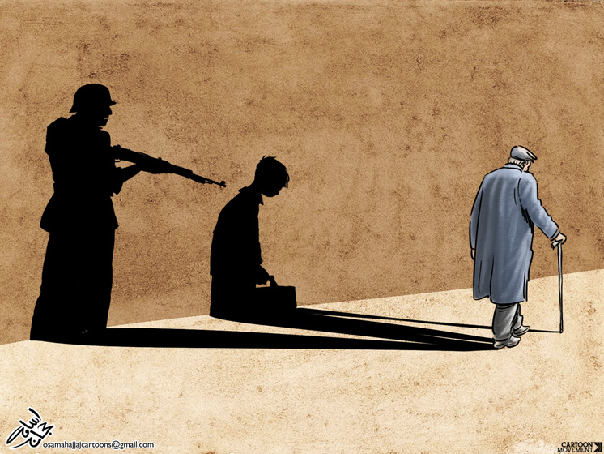
Article 19
1. States Parties shall take all appropriate legislative, administrative, social and educational measures to protect the child from all forms of physical or mental violence, injury or abuse, neglect or negligent treatment, maltreatment or exploitation, including sexual abuse, while in the care of parent(s), legal guardian(s) or any other person who has the care of the child.
2. Such protective measures should, as appropriate, include effective procedures for the establishment of social programmes to provide necessary support for the child and for those who have the care of the child, as well as for other forms of prevention and for identification, reporting, referral, investigation, treatment and follow-up of instances of child maltreatment described heretofore, and, as appropriate, for judicial involvement.
You have the right to being protected from harm, physical or mental.

Slide 7
Article 27
1. States Parties recognize the right of every child to a standard of living adequate for the child's physical, mental, spiritual, moral and social development.
2. The parent(s) or others responsible for the child have the primary responsibility to secure, within their abilities and financial capacities, the conditions of living necessary for the child's development.
3. States Parties, in accordance with national conditions and within their means, shall take appropriate measures to assist parents and others responsible for the child to implement this right and shall in case of need provide material assistance and support programmes, particularly with regard to nutrition, clothing and housing.
4. States Parties shall take all appropriate measures to secure the recovery of maintenance for the child from the parents or other persons having financial responsibility for the child, both within the State Party and from abroad. In particular, where the person having financial responsibility for the child lives in a State different from that of the child, States Parties shall promote the accession to international agreements or the conclusion of such agreements, as well as the making of other appropriate arrangements.
You have the right to food, clothing, a safe place to live and to have your basic needs met. You should not be disadvantaged so that you can't do many of the things other kids can do.

Slide 8
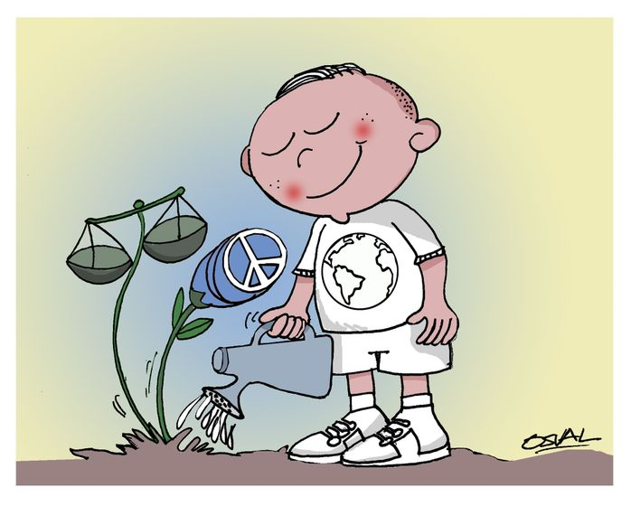
Article 30
In those States in which ethnic, religious or linguistic minorities or persons of indigenous origin exist, a child belonging to such a minority or who is indigenous shall not be denied the right, in community with other members of his or her group, to enjoy his or her own culture, to profess and practise his or her own religion, or to use his or her own language.
You have the right to
practice your own
culture, language
and religion –
or any you choose.

Slide 9
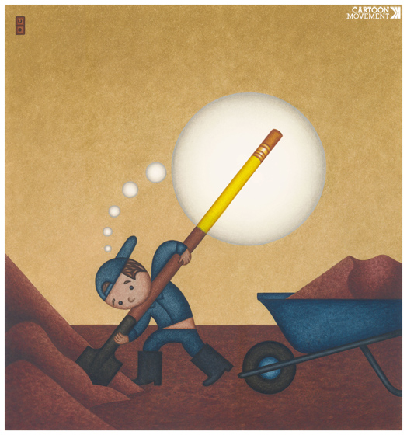
Article 31
1. States Parties recognize the right of the child to rest and leisure, to engage in play and recreational activities appropriate to the age of the child and to participate freely in cultural life and the arts.
2. States Parties shall respect and promote the right of the child to participate fully in cultural and artistic life and shall encourage the provision of appropriate and equal opportunities for cultural, artistic, recreational and leisure activity.
You have the right to rest and play.

Slide 10
Article 32
1. States Parties recognize the right of the child to be protected from economic exploitation and from performing any work that is likely to be hazardous or to interfere with the child's education, or to be harmful to the child's health or physical, mental, spiritual, moral or social development.
2. States Parties shall take legislative, administrative, social and educational measures to ensure the implementation of the present article. To this end, and having regard to the relevant provisions of other international instruments, States Parties shall in particular:
(a) Provide for a minimum age or minimum ages for admission to employment;
(b) Provide for appropriate regulation of the hours and conditions of employment;
(c) Provide for appropriate penalties or other sanctions to ensure the effective enforcement of the present article.
You have the right to protection from work that harms you, and is bad for your health and education. If you work, you have the right to be safe and paid fairly.

Slide 11
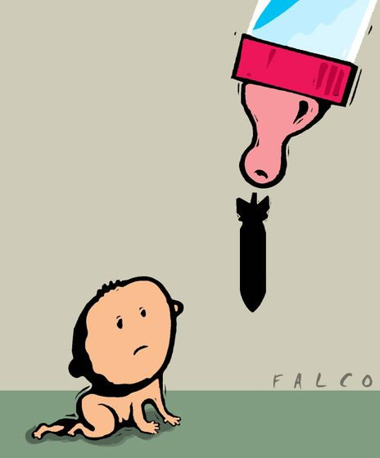
Article 39
States Parties shall take all appropriate measures to promote physical and psychological recovery and social reintegration of a child victim of: any form of neglect, exploitation, or abuse; torture or any other form of cruel, inhuman or degrading treatment or punishment; or armed conflicts. Such recovery and reintegration shall take place in an environment which fosters the health, self-respect and dignity of the child.
You have the right to help if you've been hurt, neglected or badly treated.

Slide 12
References and related links:
http://www.ohchr.org/EN/ProfessionalInterest/Pages/CRC.aspx
https://www.cartoonmovement.com/cartoon
https://www.unicef.org/rightsite/files/uncrcchilldfriendlylanguage.pdf
https://en.wikipedia.org/wiki/Convention_on_the_Rights_of_the_Child#States_party_and_signatories

