Slide 1
The european politics about refugees

Slide 2
Why do the refugees want to reach Europe
They try to:
get away from the political pressure, the war and poverty.
reunite with their families
take the advantage of the financial opportunities and the education.

Slide 3
WHAT IS THE MIGRATION CRISIS?
Many people in need of international protection are coming to the EU to seek asylum. Protection is given to people fleeing their home countries who cannot return due to a well-founded fear of persecution or risk of suffering serious harm. The EU has a legal and moral obligation to protect those in need. EU Member States are responsible for examining asylum applications and for deciding who will receive protection.

Slide 4
The measures of the EU to deal with the refugees crisis
In these measures are included:
The atempt
The impotrant help that greeks provide the refugees after their tiresome journey through aegean sea.

Slide 5
Top three nationalities of refugees who try to reach Europe

Slide 6
Genders

Slide 7
What the EU is doing?
Over the past 20 years, the European Union has put in place some of the highest common asylum standards in the world. And in the past 2 years, European migration policy has advanced in leaps and bounds as the European Agenda on Migration proposed by the European Commission in May 2015 is implemented.

Slide 8
Saving lives
The EU has increased its capacity to carry out search and rescue operations in the Mediterranean and to tackle criminal networks. By tripling the available resources, it helped save over 400 000 lives in 2015 and 2016. Over 2 000 traffickers and smugglers were caught and 375 vessels removed.

Slide 9
Reducing of the flows
The EU–Turkey Statement of March 2016 which aims to stop the uncontrolled flow of migrants across the Aegean Sea. It also provides legal ways for refugees to enter Europe. The numbers of refugees and migrants coming from Turkey have been significantly reduced as a result. From a high of 10 000 in a single day in October 2015, arrivals to Greece have averaged less than 74 a day since.

Slide 10
Reducing of the flows
The EU–Turkey Statement of March 2016 which aims to stop the uncontrolled flow of migrants across the Aegean Sea. It also provides legal ways for refugees to enter Europe. The numbers of refugees and migrants coming from Turkey have been significantly reduced as a result. From a high of 10 000 in a single day in October 2015, arrivals to Greece have averaged less than 74 a day since.

Slide 11
Tackling the root causes of migration
The EU is working with five key countries of origin and transit in Africa (Ethiopia, Mali, Niger, Nigeria and Senegal)

Slide 12
Protecting our borders
The new European Border and Coast Guard was launched in October 2016 to ensure that Europe can protect its common external borders and face the new migration and security challenges together. March 2016.

Slide 13
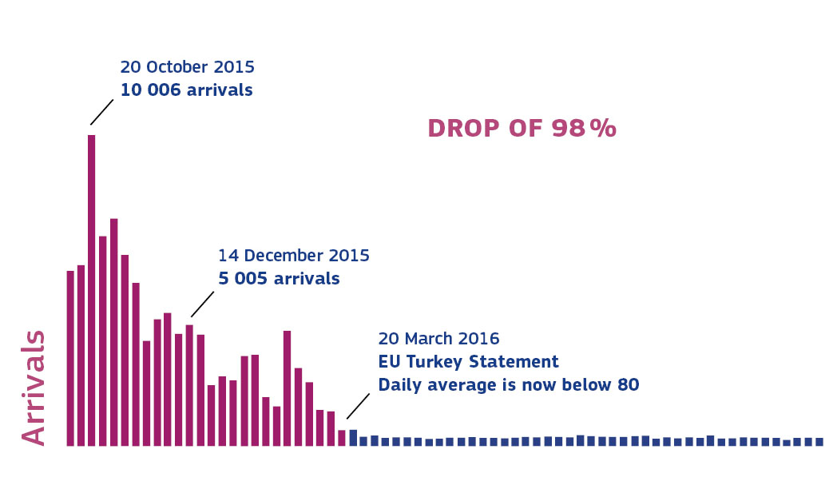

Slide 14
Opening safe pathways
An emergency relocation scheme was set up in 2015, with EU Member States committing to relocate people from Greece and Italy to other EU countries. By 21 July 2017, more than 24 000 people had been relocated — 16 774 from Greece and 2 675 from Italy — to 24 participating states. Member States should be able to relocate all those eligible by the end of 2017.

Slide 15
Showing solidarity at home and abroad
In total, €17.7 billion has been allocated from the EU budget to deal with the migration crisis in the 2015-2017 period, with €10.3 billion for planned funding outside the EU, including €2.7 billion in humanitarian aid, €0.6 billion for the Trust Fund for Syria (also known as the MADAD Fund) and €2.4 billion for the Emergency Trust Fund for Africa.

Slide 16
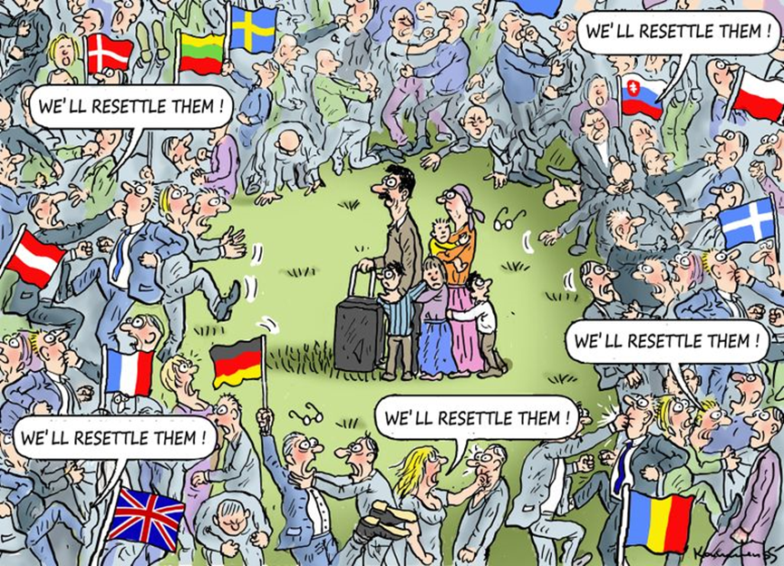
Cartoon: EU Struggles to Place Refugees
Artist: Marian Kamensky (Austria)

Slide 17
The European Union (EU) has failed to meet its goal to relocate 40,000 refugees after facing resistance from EU members Spain, Austria, and Hungary in a process the Human Rights Watch called “disgraceful.”

Slide 18
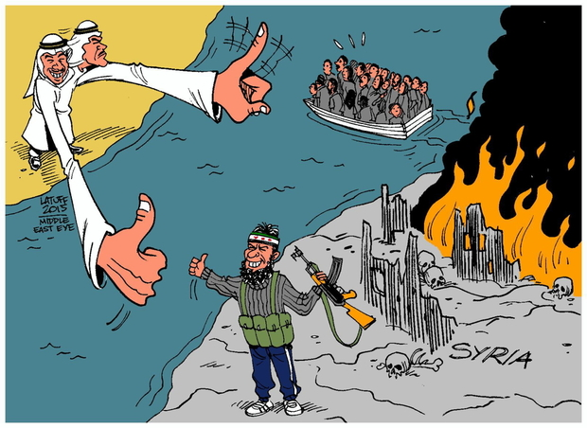

Slide 19
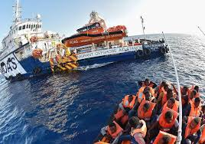

Slide 20
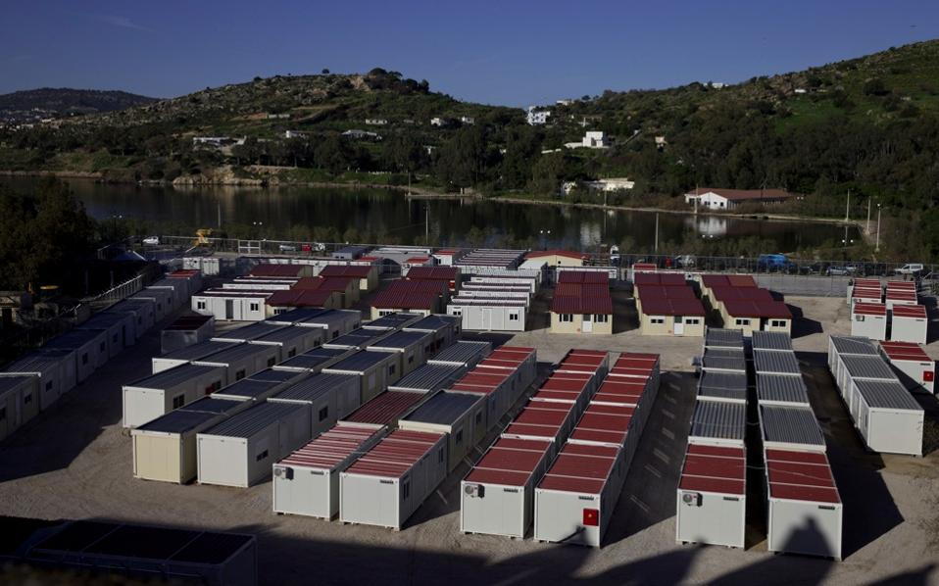

Slide 21
The European Refugee Crisis and Syria Explained
https://www.youtube.com/watch?v=RvOnXh3NN9w

Slide 22
Directed by:
Panagiotis Philippopoulos
Chatziabramidis Stelios
Ravasopoulos Giannis
Michos Efthimis

Slide 23
Resourses:
http://publications.europa.eu/webpub/com/factsheets/migration-crisis/en/#what-is-the-eu-doing
http://www.ekathimerini.com/206060/article/ekathimerini/news/ahead-of-eu-talks-greece-gets-boost-from-hot-spot-progress-tusk-comments
www.independent.co.uk/news/world/europe/refugee-crisis-latest-boat-disaster-capsizing-sinking-mediterranean-sea-libya-239-un-a7395376.html
http://kmit.in/emagazine/article/european-refugee-crisis/

Slide 24
Thank you for your attention!

