Slide 1
The rights of chlidren
Xatziabramidis Stelios

Slide 2
What mean the rights of the child?
Children's rights are the human rights of children with particular attention to the rights of special protection and care afforded to minors. The 1989 Convention on the Rights of the Child (CRC) defines a child as "any human being below the age of eighteen years, unless under the law applicable to the child, majority is attained earlier.

Slide 3
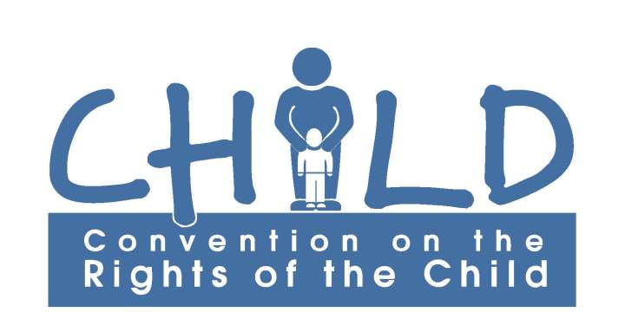

Slide 4
What are the rights of the child?
Children's rights includes:
Their right to association with both parents.
Human identity as well as the basic needs for physical protection, food, universal state-paid education, health care, and criminal laws appropriate for the age and development of the child.
Equal protection of the child's civil rights.
Freedom from discrimination on the basis of the child's race.

Slide 5
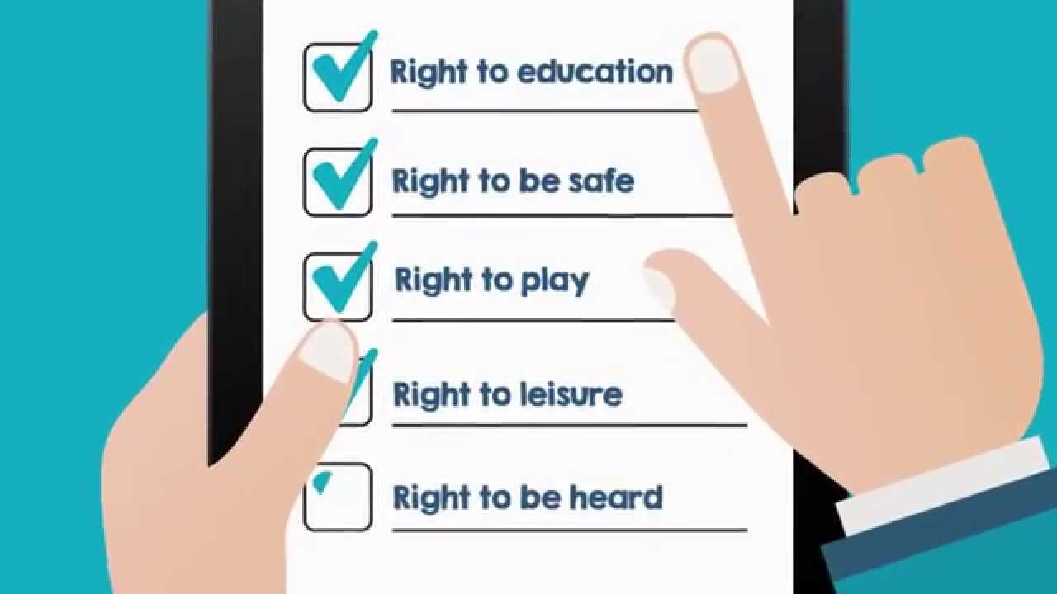

Slide 6
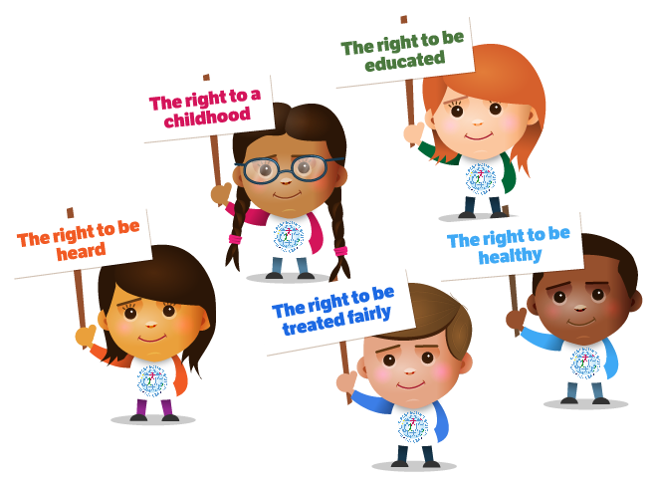
The basics of the children's right
The basics of the children's right is : child's race, gender, sexual orientation, gender identity, national origin, religion, disability, color, ethnicity, or other characteristics.

Slide 7
Interpretations of children's rights
interpretations of children's rights range from allowing children the capacity for autonomous action to the enforcement of children being physically, mentally and emotionally free from abuse, though what constitutes "abuse" is a matter of debate. Other definitions include the rights to care and nurturing.

Slide 8
Sources
https://en.wikipedia.org/wiki/Children%27s_rights

