Slide 1
Questionnaire Results
Brief Presentation

Slide 2
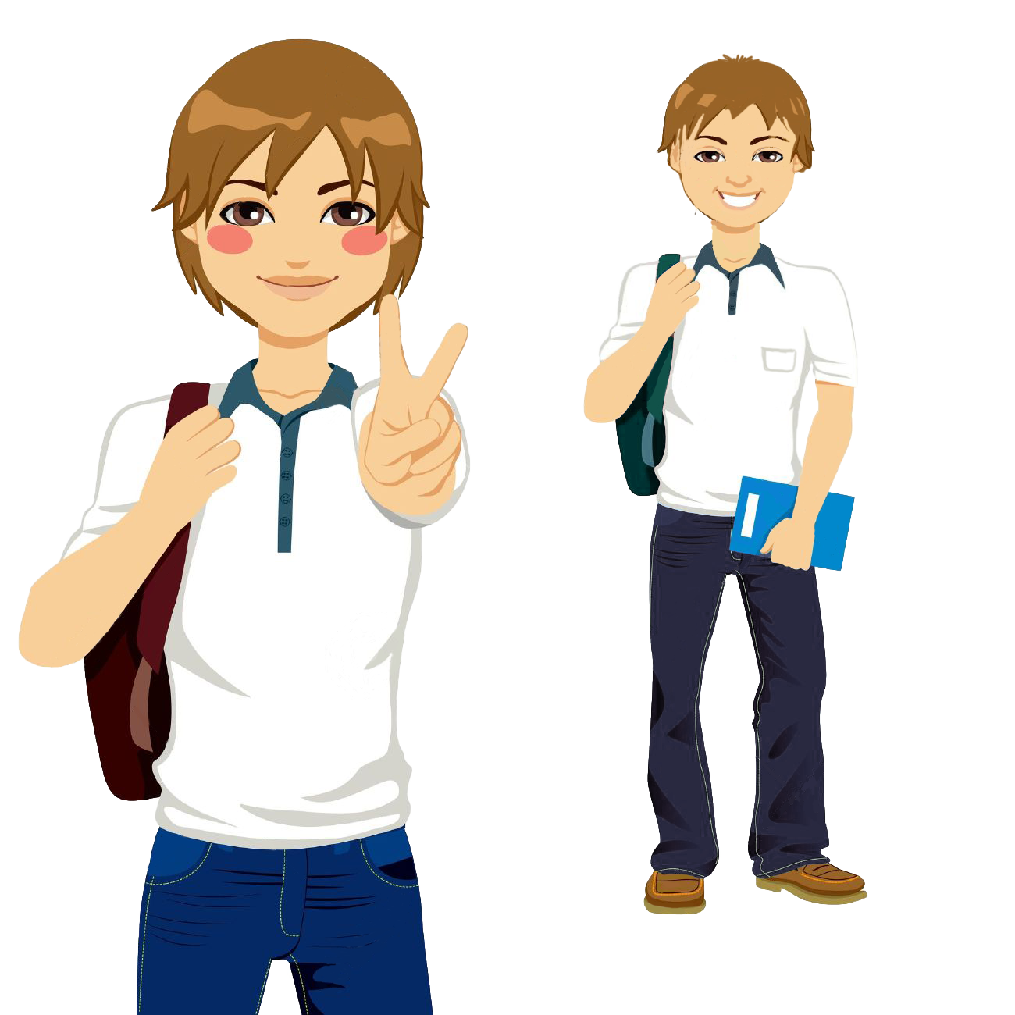
Τhe majority of the responses came from female students (58%).Moreover, most students of the who responded to the questionnaire are 13 years old so they are in the second grade of the Greek Junior High School (or 7th graders in the European system) .

Slide 3
Most respondents have met a refugee and 78% of them have friends or relatives who have fled abroad.
The fact that 52% would like refugees to have the same rights and obligations with the locals is encouraging.

Slide 4
75% of the students believe that it is not a good choice for refugees to stay in Greece, while it is not clear ( for the students) if refugees would like to return to their homeland.
It cannot be clearly detected whether the refugee culture could affect our own

Slide 5
There is no clear picture if Greece is threatened by refugees - the responses tend to be negative. Although the number of refugees is large, students do not believe that refugees are better treated than Greeks.

Slide 6
A large percentage (68% ) considers that there must be job equality with the locals and 78% that refugees should have the same social benefits.

Slide 7
45% responded that every refugee should be taught their native language through the Greek school and 66% agreed to learn the language of the country they choose to live

Slide 8
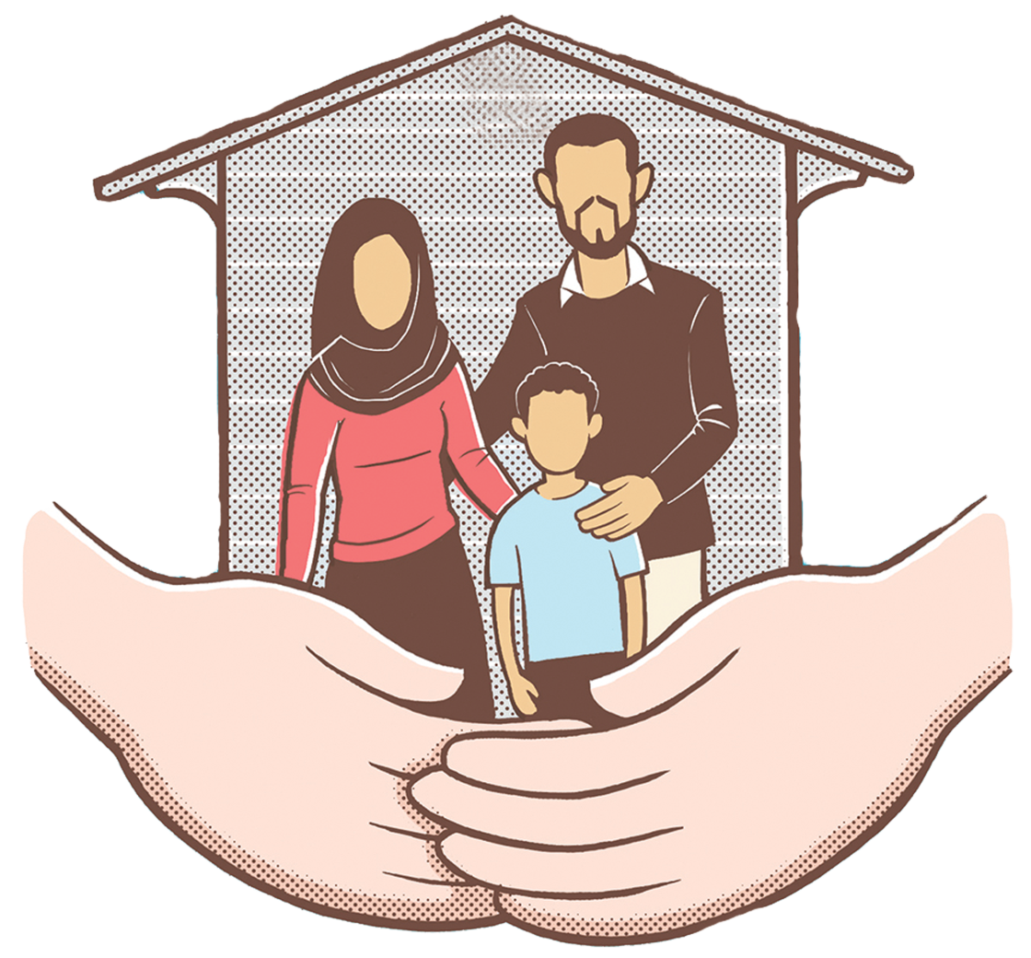
The overwhelming majority thinks that refugees should be reunited with their families abroad.

Slide 9
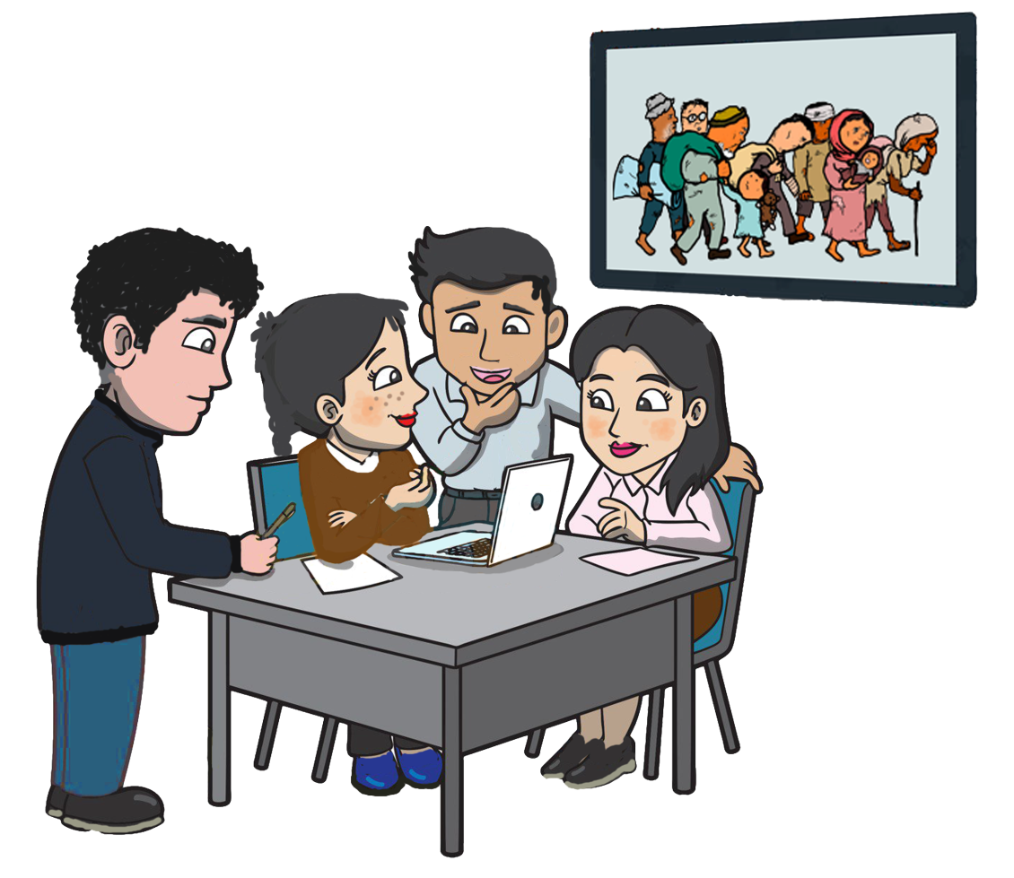
The refugee issue is not the favorite topic among friends, but half of the interviewed students have discussed this subject with their families as the issue is of great interest to them.
There is a positive tendency to be informed about the refugee problem and this is done through television or the internet. However, only few students upload issues related to the refugees on social networking pages.

Slide 10
The students responded that it is their teachers that present a variety of views on refugee matters, although the teachers encourage them to freely express their views on the refugee problem.
The overwhelming majority, 80%, thinks that the refugee issue has been discussed in school.

Slide 11
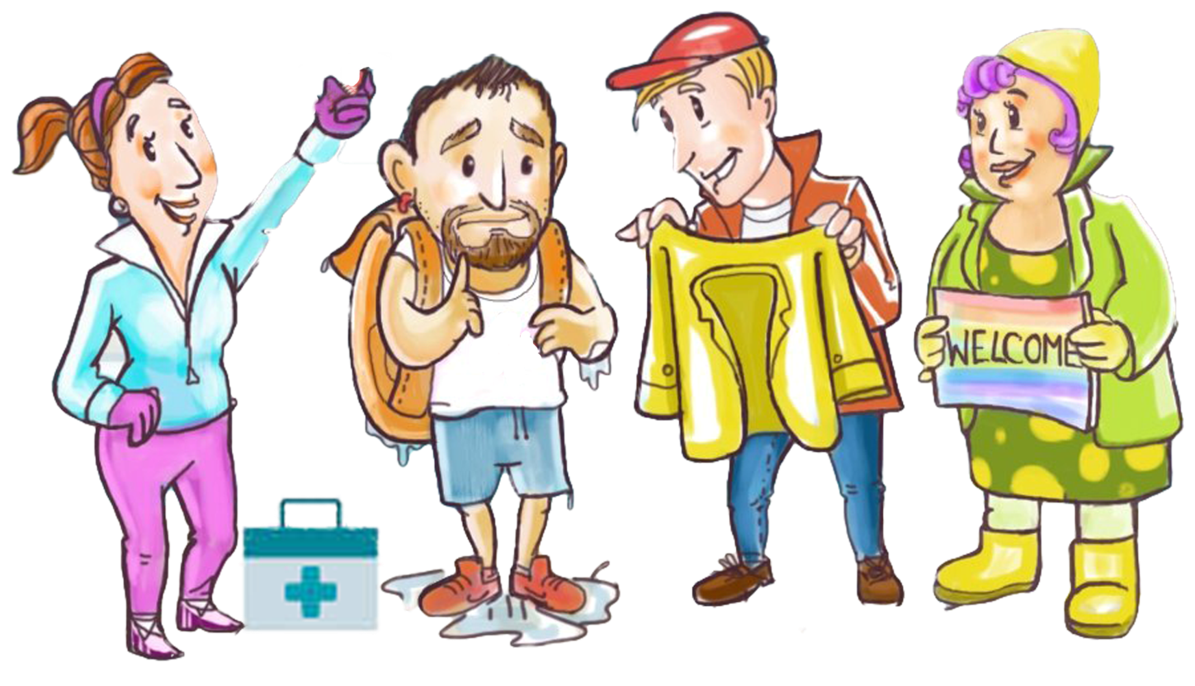
74% of students would collect clothing, food for refugees and would be pleased to support them in health care or in finding a job .

Slide 12
78% would help them learn Greek.

Slide 13
There is a positive tendency (50%) to help as a refugee’s camp volunteer but a negative tendency to participate in a refugees support demonstration, and they remain rather indifferent towards the information campaign.

Slide 14
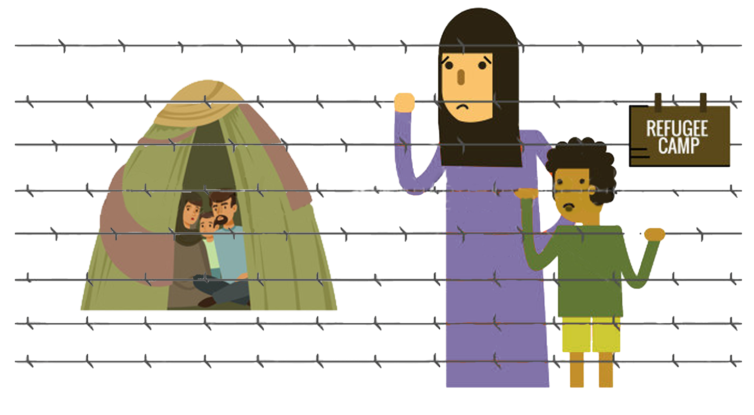
They believe that people are not sufficiently informed about the refugee's living conditions.
They also believe that the State should take more responsibility for the social integration of refugees and that it does not support their hosting well. A large number of students understand the problems and difficulties of refugees and they would like to do something to help them if there was some kind of organized support by the authorities.
Students believe that the public is not well informed about the problems and living conditions of refugees. Informing people is considered incomplete.

Slide 15
Several students believe that refugees will have a positively treated by the students at school.

Slide 16
Thank you for your attention
https://refugexperience.weebly.com/

