Slide 1
The black pages of expulsion

Slide 2
The meaning of refugee
According to the Geneva Convention on Refugees, a refugee is called any person outside the state of which he is a citizen because of a justified fear. The fear is that he will suffer persecution because of his race, religion or nationality or even because of his status as a member of a particular social group or his / her political views (a political refugee).In addition, it is impossible for him / her to obtain protection from his / her country , out of fear, he does not wish to be protected.

Slide 3
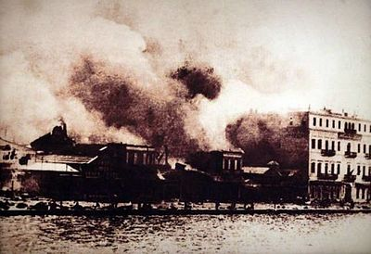
The “Asia Minor Catastrophe”
The "Asia Minor Catastrophe" describes the last phase of the Asia Minor campaign and the end of the "Greek-Turkish War of 1919-22“. The Greek army wanted to protect the population of the area. However, Greece did not manage to win the war. The front collapsed. This resulted to the widespread expulsion of a large part of the Greek and Christian population from Asia Minor.

Slide 4
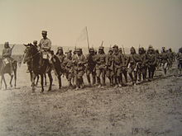
Some causes of this catastrophe
The division of Greek society and politics into “royalists" and "Venizelists".
Diplomatic isolation of Greece due to: (a) the return of King Constantine and (b) the diplomatic skills of Kemal Ataturk.
The continuation of the military operations in Asia Minor, despite the counterproductive promises of the government.
The military capabilities of Kemal and the nationalism of the Turks.

Slide 5
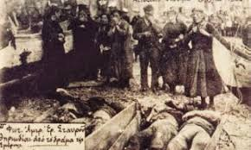
Armenian Genocide
The Armenians were also persecuted by the Turkish army. Only in September 1920 50.000 Armenians were executed

Slide 6
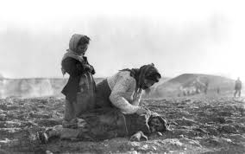
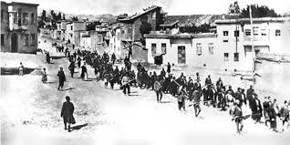

Slide 7
The elimination of the Greeks of Asia Minor
The Turks wanted to eliminate every Greek element from Asia Minor, committing crimes. According to the testimonies of the Western eyewitnesses there were massive burnings of buildings, rape, massacres, executions, torture, etc. According to the London Times correspondent, many Christians were burned in their churches when they fled to them, and the Turks were putting fire on them. Also America witnesses verifying the same stories.

Slide 8
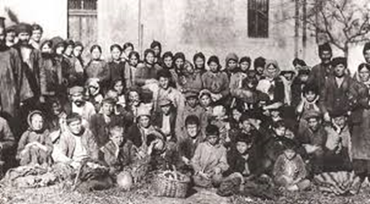
Children of Asia Minor

Slide 9
Testimonies from survivors
The people who survived sled to Greece, the nearby Greek islands of Lesvos, Chios and Samos. Also, some of them are still alive and the only thing that they can say is that the “Asia Minor Catastrophe” was one of the most sorrowful and deadly events of all the times.

Slide 10
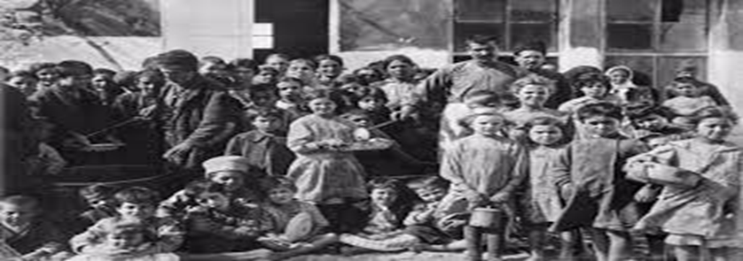
Survivors from “Asia Minor Catastrophe”

Slide 11
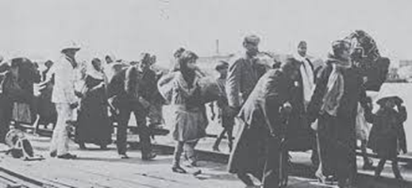
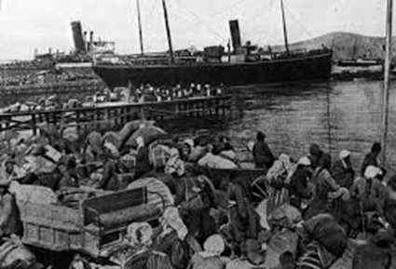
Refugees of Asia Minor coming to Greece

Slide 12
Books about “Asia Minor Catastrophe”
1) Smyrna 1922: The Destruction of a City by Marjorie Housepian Dobkin
2) Paradise Lost: Smyrna, 1922 by Giles Milton
3) The Great Fire by Lou Ureneck
4) Certain Samaritans by Esther Pohl Lovejoy
5) Crossing the Aegean
And many others…

Slide 13
The results
The results of the Asia Minor disaster were catastrophic. After the destruction of Smyrna and the Moudania truce(11 October 1922). Also one month after the emptying of the Gallipolis peninsula (on November 11) by the Greeks who lived there, the "forced population exchange" (1922-24) took place. Furthermore, the arrival of 1.5 million refugees in Greece, concluded in the complete destruction of Asia Minor Hellenism along with the Pontus.

Slide 14
“Asia Minor Catastrophe” was a very violent fact for all the citizens of Asia Minor. Unfortunately, this harmful events are continuing nowadays. However, the reason that they are taking place, is different than then.

Slide 15
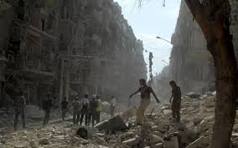
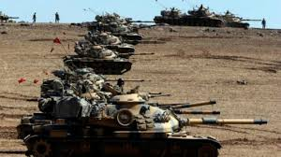
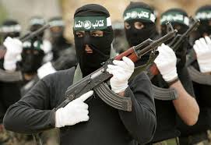

Slide 16
Some years ago, in the Middle East and particularly in countries like Iraq and Syria, civil strifes broke out. People decided to flee to another country, in order to save their lives. However, due to the fact that they did not have transport, they have to cover the distance on foot or with various means of transport, and without having passport.

Slide 17
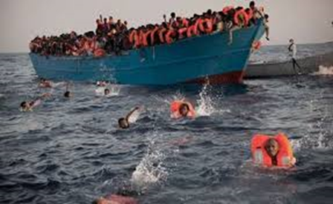
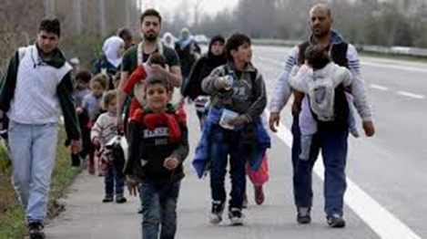
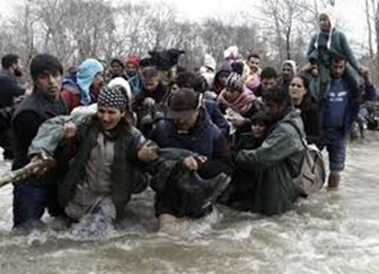
The big journey

Slide 18
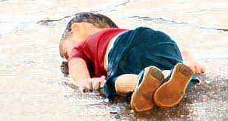
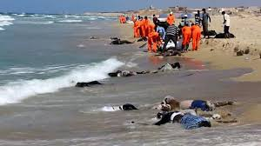
However, some of them, didn’t manage to survive

Slide 19
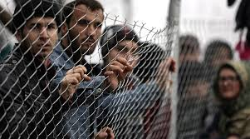
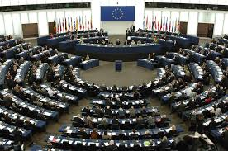
The obligations of Europe
The European countries need to help the refuges by allowing entry to their countries. Also they should provide shelter, food and stay until their safe return to their homes.

Slide 20
Written and directed by Panagiotis Filippopoulos
Class: Β3
School: 13th High School of Patras

Slide 21
Thank you for your attention.

